Slide 1

Undergraduate Public Health: Non-traditional and here to stay!
Lauren D. Arnold, PhD, MPH
Director, Undergraduate Public Health Programs
Associate Professor, Dept of Epidemiology & Biostatistics

Slide 2
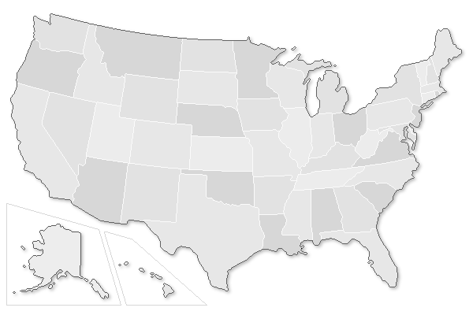
1,340
176
45
11,800
Image: https://www.fws.gov/endangered/species/
Notes:
1992 – 45 college/schools with undergrad PH degrees
2012 - 176 college/schools with undergrad PH degrees
HP 2020 – Increase # of BSPH degrees awarded to ~11,800
www.biomedcentral.com/track/pdf/10.1186/s40985-016-0048-x?site=publichealthreviews.biomedcentral.com
2003: 1,340 BS degrees
2015: 10,700 (HP2020 data)
2020: 11,800 (HP2020 goal)

Slide 3
UGPH Consensus Conference
Educated Citizen & PH
APHA Resolution
Welch-Rose Report
CEPH SBP Accreditation
Undergrad LOs
IOM
Report
CCEs
?
1915
2003
2016
2012
2020+
2006
2007
2011
2009
Notes:
2003 IOM – PH should be available to all undergrads, regardless of major
2006: Consensus conference – recommended “101” classes (EPI, Intro PH,
Educated Citizen - collaborative effort that aimed to integrate public health principles into a liberal arts undergraduate education
LEAP - focus was on suggesting how institutions could integrate public health into existing educational opportunities; examples were related to journalism, public policy, political science, and communications courses

Slide 4
Schools/Colleges of PH
Liberal Arts Institutions
Research Institutions
Rutgers
Johns Hopkins
Health Ed & Promotion
Human Ecology
East Tennessee State
Health Sciences
Anthropology
Exercise Science
Image: https://www.fws.gov/endangered/species/
Notes:
Anthropology, Health Sciences, Exercise Science, Kinesiology, and Health Education and Promotion
70% outside of schools that offer a graduate public health degree (2008)
Rutgers, Hopkins, Lindenwood
Schools/College of Public Health
School of Human Ecology – UT-Austin
Health Sciences – Cedar Crest College, Lindenwood
Health Ed & Promotion – ECU
Anthropology – University of Louisville
Exercise Science – Appalachian State, University of North Dakota
Kinesiology – Iowa State
Health Studies – American University
Liberal arts institutions
Departments of Anthropology, Health Sciences, Exercise Science, Kinesiology, and Health Education and Promotion

Slide 5
Pre-professional
Liberal Arts
Notes:
2003 IOM – PH should be available to all undergrads, regardless of major
Educated Citizen - collaborative effort that aimed to integrate public health principles into a liberal arts undergraduate education
LEAP - focus was on suggesting how institutions could integrate public health into existing educational opportunities; examples were related to journalism, public policy, political science, and communications courses

Slide 6
Curriculum
✓
Liberal arts coursework
✓
Field experience
✓
Capstone
✓
Career preparation
✓
Professional development
✓
“Other stuff”

Slide 7

Image courtesy of Keerati at FreeDigitalPhotos.net
Transfer students
Accelerated
Study Abroad
Pre-med
“Core”
Major
Electives
Double Majors
Athletes
Major changers
Minor(s)

Slide 8
Things to Keep Us Busy
No “cohorts”
Increasing class sizes
“Standard” course requirements
Faculty variation
  Rooted in graduate education
  Without (formal) public health training/degrees
  Recruited from community faculty
Advising

Slide 9
Take Home Messages
The staggering growth in undergraduate public health programs over the last decade has changed the face of public health education.
The field has been forced to re-examine the context for teaching public health and consider the purpose of bachelor’s level training, including how it fits in with MPH and doctoral education.
There is a need for undergraduate public health programs to engage in discussion and assessment about best practices for teaching, advising, and supporting professional development in their students and to disseminate this information through peer reviewed literature.

